Slide 1
Basic Statistics Dispersion Measures

Slide 2
Topics
Moments
Standard Deviation and Variance
Inter-quartile Range, Range, Mean difference
Co-efficient of Variation
Skewness
Kurtosis

Slide 3


Moments
Concept of moments evolved from physics and is extremely helpful in understanding real valued functions
Moment of a RVF f(x) about a point c is conceptually defined as
Generally defined about c=0 it becomes the n^{th} moment of f(x) or Expected value of X^{n}
First Moment about 0 is Mean of a pdf (probability density function)
Moments when taken about Mean are called central moments
Second Central Moment is Variance (sq rt of which is Std Dev)
Third Central Moment when normalized is called Skewness
Fourth Central Moment minus 3 is called Kurtosis
Any distribution could be reasonably understood by knowing about Mean, Variance, Skewness and Kurtosis

Slide 4
Product-moments of random variables

Slide 5



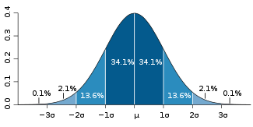
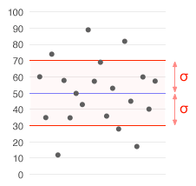
Variance
Variance is a widely used measure for variability or dispersion
Indicates dispersion, spread, variation, deviation
Properties of Standard Deviation :
Graphical Representation :
Related Topics (Self Help) : Expected Deviation/Average Absolute Deviation
where

Slide 6
Variance (contd.)
For single population or sample data:
where σ² and s² = population and sample variance respectively, x_{i} = individual observations, μ = population mean, = sample mean, and n = total number of individual observations.
The square roots are:
standard deviation standard deviation

Slide 7
Variance Calculation
Std. dev. of a frequency distribution
The following table shows the age distribution of second-time home buyers:
x^

Slide 8
Variance Importance
Why “measure of dispersion” important?
Consider returns from two categories of shares:
* Shares A (%) = {1.8, 1.9, 2.0, 2.1, 3.6}
* Shares B (%) = {1.0, 1.5, 2.0, 3.0, 3.9}
Mean A = mean B = 2.28%
But, different variability!
Var(A) = 0.557, Var(B) = 1.367
* Would you invest in category A shares or
category B shares?

Slide 9
Relationship Between the Measures of Dispersion
As n increases, accuracy of Range decreases
Use Range when there is small amount of data or data is too scattered
If n> 10 use standard deviation
A smaller standard deviation means better quality

Slide 10
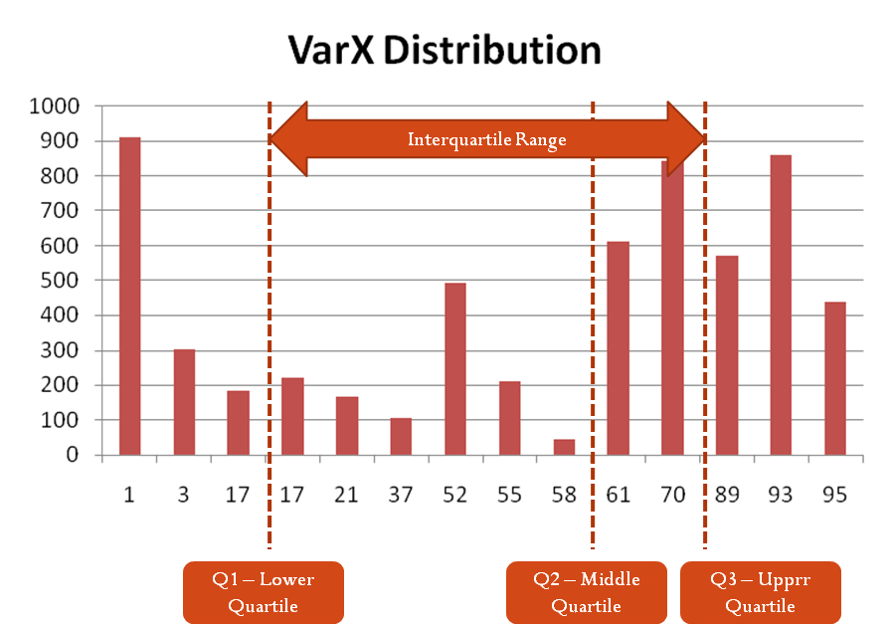


Other Measures
Inter-quartile Range
= (Q₃ – Q₁ )
Range : Length of smallest interval which contains all the data
= max(f(x))-min(f(x))
Mean Difference is the average absolute difference of two independent values drawn from a probability distribution.
Discrete Probability Distribution
N size Population

Slide 11
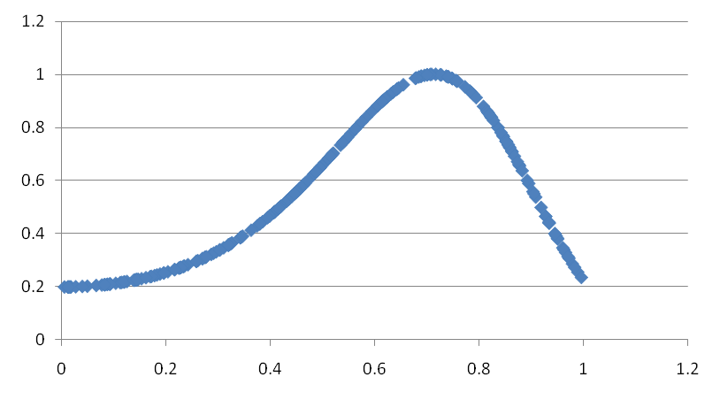
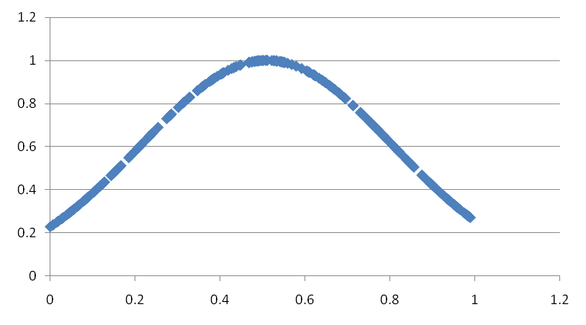
Skewness
Skewness measures the lopsidedness of any given distribution
Any symmetric distribution will have γ= 0 provided it exists
Graphical Representation :
Skewed right (γ>0)
No Skew (γ=0)

Slide 12

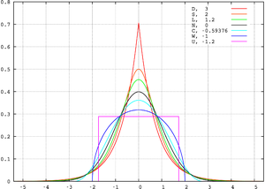
Kurtosis
Kurtosis is a measure of peakedness of a distribution
Higher Kurtosis may imply that variance is constituted vastly of data extremities over a rather equalist division
Definition excess kurtosis where kappa’s are n^{th} cumulants
Mesokurtic : 0 Excess Kurtosis
Leptokurtic : +^{ve} Excess Kurtosis
Platykurtic : -^{ve} Excess Kurtosis

Slide 13

Coefficient of Variation
Correlation variation (CV) is a measure of how much variation exists in relation to the mean
Co-efficient of variation : Useful for positive distributions with non zero mean.
Std. deviation as % of the mean:
Could be a better measure compared to std. dev.
COV(A) = 32.73%, COV(B) = 51.28%

